Slide 1
Md. Abdul Malek Assistant Professor, Dept. of Electrical & Electronic Engineering (EEE) Rajshahi University of Engineering & Technology (RUET)

Slide 2
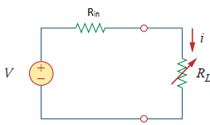
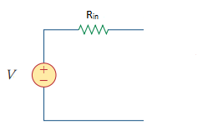
Maximum Power Transfer Theorem
Practical source have internal resistance.
Power loss occurred in the internal resistance.
In any electric circuit, the electrical energy is delivered to the load where it is converted into a useful work.
For given circuit with known internal resistance, the load size always affects the amount of power transferred from the supply source.
Any change in the load resistance results to change in power transfer to the load.

Slide 3

Maximum Power Transfer Theorem
Our main objective to deliver maximum power to load.
Maximum power transfer theorem determine the condition that transfer the maximum power to the load.

Slide 4
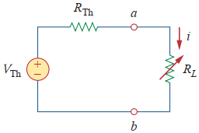

Maximum Power Transfer Theorem
The Thevenin equivalent is useful in finding the maximum power a linear circuit can deliver to a load.
Fig. 1: Thevenin equivalent circuit.
The power delivered to the load is

Slide 5
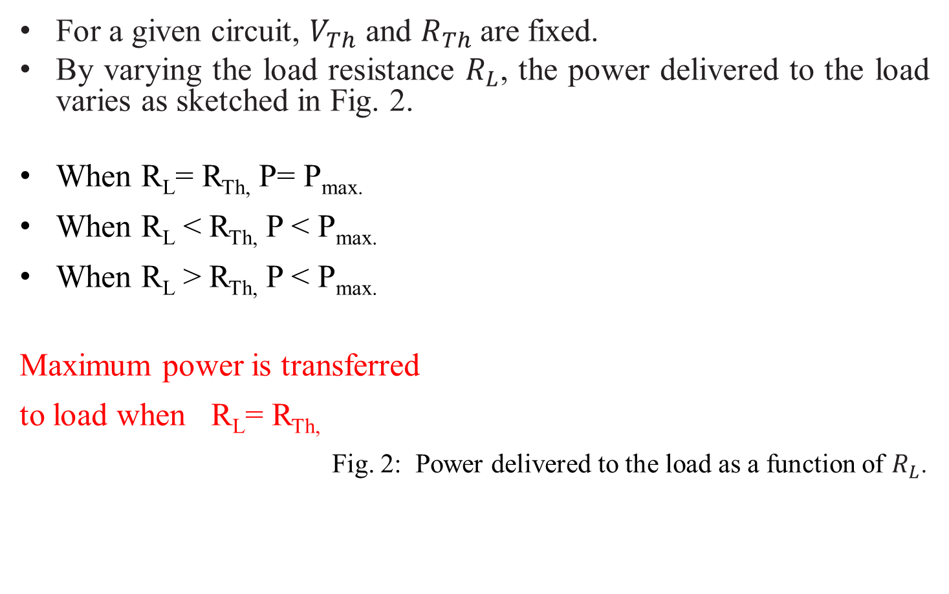
Maximum Power Transfer Theorem
For a given circuit, $V_{Th}$ and $R_{Th}$are fixed.
By varying the load resistance $R_{L}$, the power delivered to the load varies as sketched in Fig. 2.
When R_{L}= R_{Th,} P= P_{max.}
When R_{L} < R_{Th,} P < P_{max.}
When R_{L} > R_{Th,} P < P_{max.}
Maximum power is transferred
to load when R_{L}= R_{Th,}
Fig. 2: Power delivered to the load as a function of $R_{L}$.

Slide 6
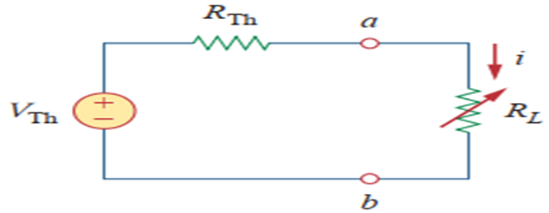



Maximum Power Transfer Theorem
Maximum power theorem:
Maximum power is transferred to the load when the load resistance equals to the Thevenin resistance (R_{L}= R_{Th}).
Derivation:
Power delivered to the load R_{L} is

Slide 7





Maximum Power Transfer Theorem
We Differentiate equation (1) with respect to R_{L} and set the result equal to zero
But

Slide 8
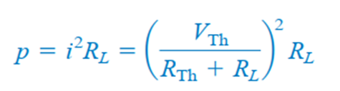

Maximum Power Transfer Theorem
The maximum power transferred to the load is

Slide 9
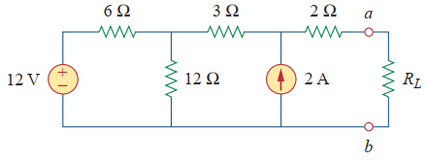
Maximum Power Transfer Theorem
Find the value of load for maximum power transfer in the circuit of Fig. 3. Find the maximum power.
Fig. 3

Slide 10
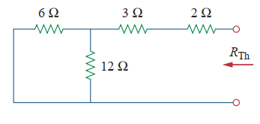
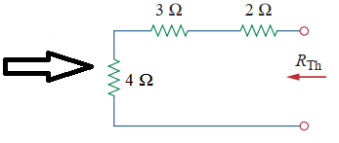




Maximum Power Transfer Theorem
Solution: To determine the maximum power to the load, we need Thevenin’s circuit of Fig. 3.
R_{Th}:
Turning off the 12 V voltage source (replacing it with a short circuit) and 2 A current source (replace with open circuit)
Load terminal replace with open circuit.
6 Ω and 12 Ω resistors is connected in parallel
Combine 6 Ω and 12 Ω resistors

Slide 11
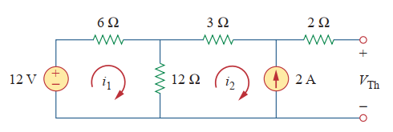



Maximum Power Transfer Theorem
To get V_{Th}, we consider the circuit in Fig. 4
Fig. 4.: finding V_{Th.}
From mesh 2,
From mesh 1,

Slide 12

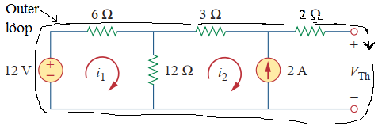


Maximum Power Transfer Theorem
From equation (2) and (3),
Applying KVL around the outer loop to get V_{Th} across terminals a-b,

Slide 13


Maximum Power Transfer Theorem
For maximum power transfer,
Maximum power at load is

Slide 14
Thank You

